Slide 1
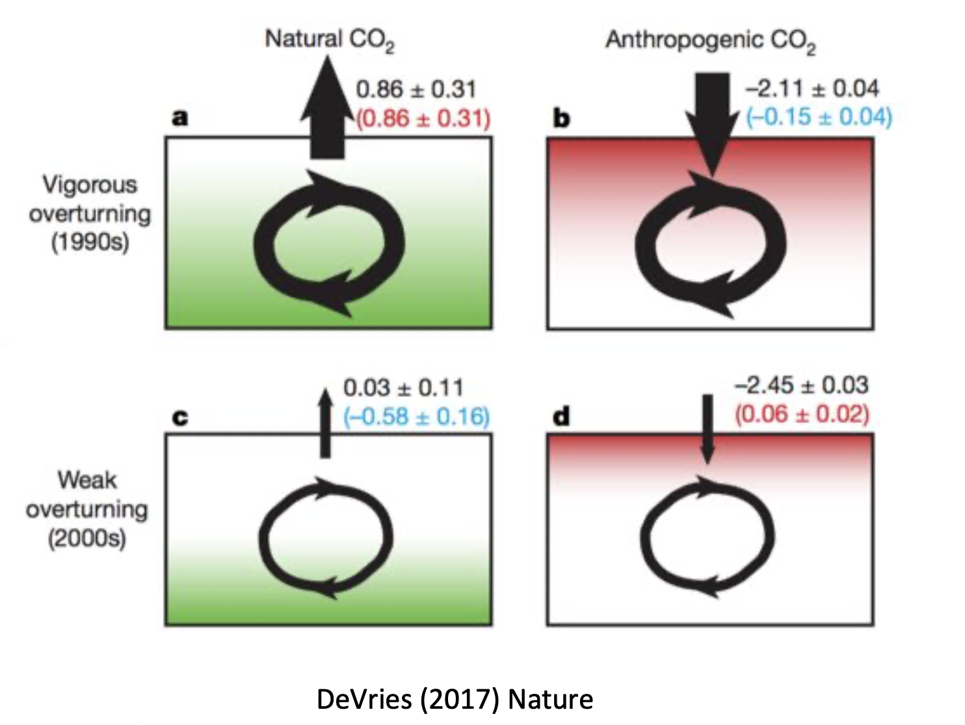
Sequestration in the SO depends on vigorous global ocean ciruclation

Slide 2
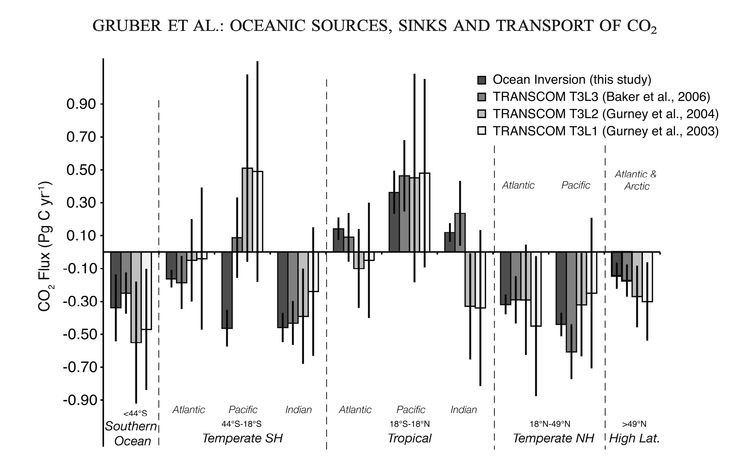
Gruber et al, 2008, Oceanic sources, sinks, and transport of atmospheric CO2
Some oceans are sources, some are sinks!
Figure 3
1 PgC = 1 GtC
CO₂ goes into the ocean (from the atmosphere)
CO₂ comes out of the ocean (and into the atmosphere)

Slide 3
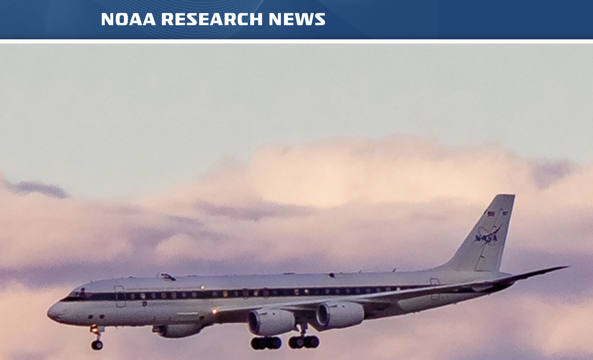
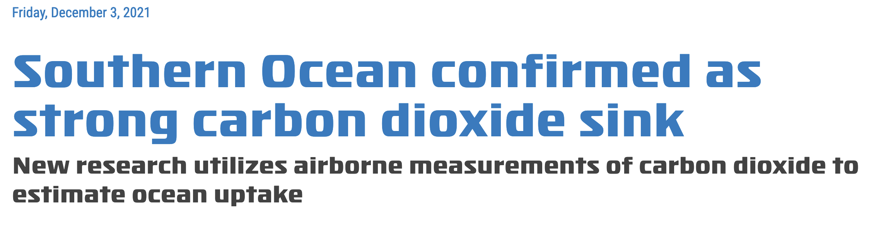
Some of this has only been nailed down recently, however (2021!)

